Slide 1
Windows Phone 8 Sensors
Matthias Shapiro
mashapir@microsoft.com
http://matthiasshapiro.com

Slide 2
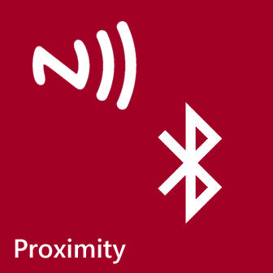
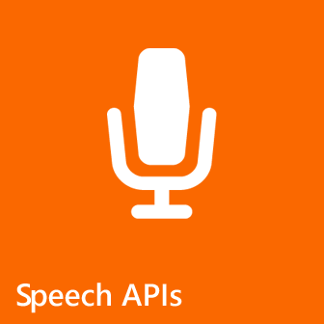
Windows Phone 8 Sensors
Notes:
Microsoft provides a lot of superb functionality that lives on top of some of these sensors. As a result, instead of talking about the microphone as a sensor, we’re going to talk about the Speech API that uses the microphone and gives developers an enormous head-start in creating exceptional high-quality applications.
In terms of specific topics, we’re going to cover proximity sensors including Near Field Communication and Bluetooth, GPS and mapping, the Wallet functionality, Speech APIs

Slide 3
Windows Phone 8 Sensors
Motion APIs
Accelerometer
Compass
Gyroscope (Enhanced Motion)
Voice over IP (VoIP)
Notes:
Not covered here but worth mentioning are the accelerometer for motion sensing, the Compass, which can be used to enhance location applications by providing the heading of the phone, and the Gyroscope sensor is used to determine the rotational velocity of the device in each axis.
If you’re interested in exploring these features further, you should investigate the Motion APIs when collect this data together and deliver it in a common, clean method.

Slide 4
Windows Phone 8 Sensors
Notes:
Let’s start off with the Geolocation and Maps.

Slide 5
New Windows Phone Runtime Location API
Replaces Bing Maps
Supports Managed and Native code
Converges with Windows 8
Improved one-shot location acquisition
<Map> XAML Control
Notes:
With Windows Phone 8, we’re switching location and mapping in Windows Phone from Bing Maps to the new Windows Phone Runtime Location API. This is probably one of the biggest changes for developers in the WinPhone 8. We’re doing this in part because we knew we needed to be able to make this capability available in both managed and native code and, with that, it made sense to converge this capability on the phone with the same capability in Windows 8.
But with this change we also have much improved “One-shot” location acquisition. This means that if you simply need to know where you user is but you don’t need to track their location, you can do this in a fast, energy efficient way.
Finally, we have the new Map XAML control to replace the Bing Maps control used in Windows Phone 7. The Map control does not require any registration, token, or download. Just drop it into your XAML and you have an interactive map.

Slide 6
New Windows Phone Runtime Location API
Windows Phone 7 .NET location API
FULLY SUPPORTED
HOWEVER
Notes:
But before I talk about how to use this new system, I want to point out that the Windows Phone 7 .NET API and the related classes are fully supported. If you have a Windows Phone 7 application that makes use of these APIs, you do not need to start from scratch. You can pull your old Windows Phone 7 code into Windows Phone 8 and you will have the full functionality you had before.
However.
In the interest of looking toward the future, I would recommend starting new projects using the new Windows Phone Runtime API and begin planning how you will transfer code in old projects from the Bing APIs to the new Windows Phone RT version. As mentioned before, this not only future proofs your code but it will bring your app in line with Windows 8 GeoLocation practices.

Slide 7
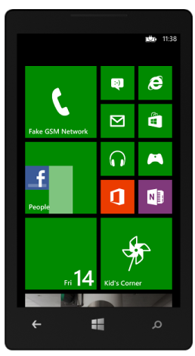
Location Sources
GPS
+ Accuracy
- Power
- Speed
- Indoors
- Accuracy
+ Power
+ Speed
- Wilderness
WiFi
+/- Accuracy
+/- Power
+/- Speed
+/- Urban areas
Cell Towers
Location Services
Notes:
The Windows Phone location service pulls location data from GPS satelites, cell towers and WiFi positioning. Individually, these methods all have their pros and cons in terms of accuracy and speed, but the location service pulls the best information as quickly as possible and delivers it as the result, refining that result as it gathers more details.

Slide 8
How to Get the Phone’s Current Location
Geolocator geolocator = new Geolocator();
geolocator.DesiredAccuracyInMeters = 50;
Geoposition myLocation = await geolocator.GetGeopositionAsync(maximumAge, timeout);
// We need to convert the Geoposition to a GeoCoordinate to show it on the map
GeoCoordinate geoCord = new GeoCoordinate(myLocation.Coordinate.Latitude, myLocation.Coordinate.Longitude);
MyMapControl.Center = geoCord;
// Set up an event handler to watch for location updates
GeoCoordinate geolocator.PositionChanged += updatePosition;
(Visual Studio)
Notes:
This method initializes the Geolocator object and sets the DesiredAccuracyInMeters property. Next, the GetGeopositionAsync method is called. This method attempts to obtain the phone’s current location. It does this asynchronously so that the UI thread is not blocked while the location is obtained. You can use the await operator to place code after the asynchronous call that will be executed after the call finishes. This requires this handler method to be declared async.
The whole location operation is wrapped in a try block in case any exceptions are thrown. If an UnauthorizedAccessException exception is thrown while you are developing, it could mean that you haven’t included ID_CAP_LOCATION in your app manifest. If this happens after your app has been deployed, it may mean that the user has disabled location for this app in the phone Settings.
In the call to Geolocator.GetGeopositionAsync, the parameters havethe following meaning:
maximumAge: If a location is in the cache and its age is less than or equal to this parameter, the cached value is returned rather than a new position retrieved
Timeout: If a cached location is not available, this timeout applies to attempts to get a new position fix. A TimeoutExceeded exception is thrown if no position can be retrieved within this time limit.

Slide 9
Position Changed
void newPosition(Geolocator sender, PositionChangedEventArgs args)
{
Deployment.Current.Dispatcher.BeginInvoke(() =>
{
GeoCoordinate geoCord =
new GeoCoordinate(args.Position.Coordinate.Latitude,
args.Position.Coordinate.Longitude);
MyMapControl.Center = geoCord;
});
}
Notes:
If we want to continue to watch the location, we simply implement an event handler that watches for tht new position. It will return that position off the UI thread, so we need to move the application to the UI thread if we want to update our map UI.

Slide 10
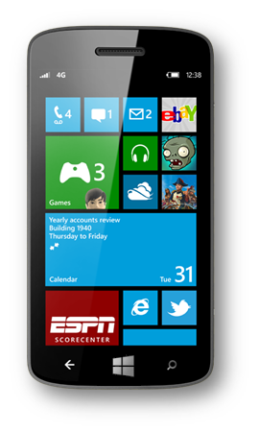
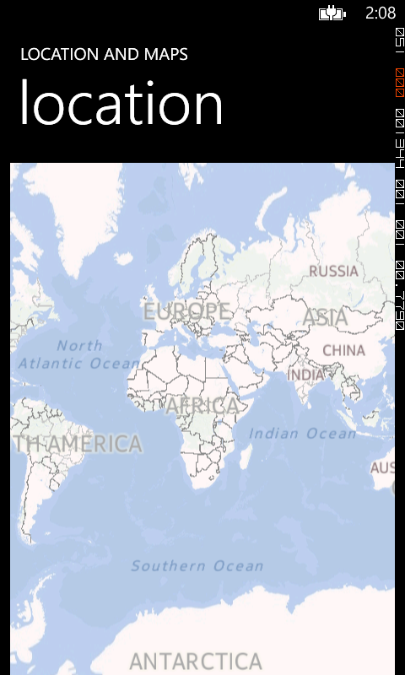
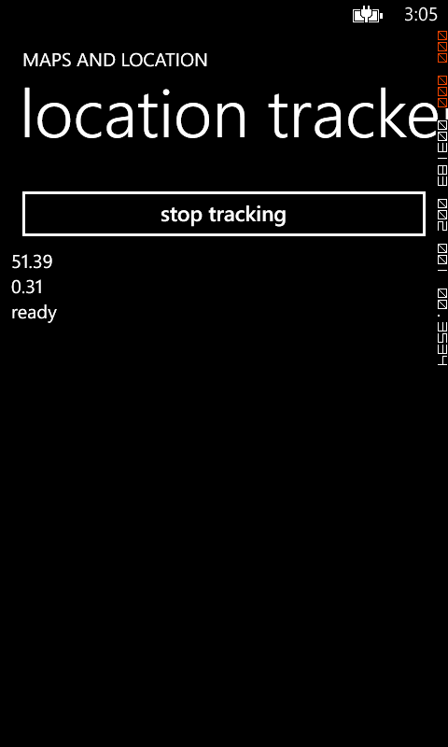
Maps APIs on Windows Phone 8
Windows Phone 8 has new Map control namespaces:
Microsoft.Phone.Maps
Microsoft.Phone.Maps.Controls
Microsoft.Phone.Maps.Services
Notes:
Let’s take a quick look at the new mapping UI that we have in Windos Phone 8. We’ll need to remember 3 new namespaces for that UI, seen here. These namespaces are for things like the Map, the MapLayers and Shapes as well as the ability to query for routes on our map.

Slide 11
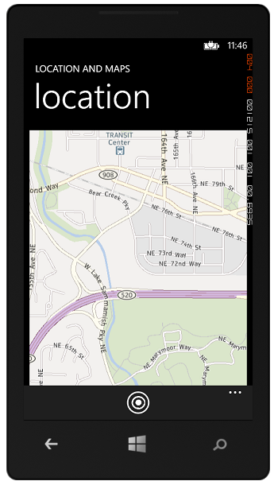
Map Control
Add a Map to your UI
<Grid x:Name="ContentPanel" > <maps:Map x:Name="MyMap"/> </Grid>
In Code:
private void CreateMap() { Map MyMap = new Map(); ContentPanel.Children.Add(MyMap); }
Notes:
Adding a map to our applicatuin is as simple as can be. We can either add a map using the “Map” control in XAML or in code. Anyone familiar with Windows phone will probably laugh at how easy this is, especially compared to the Bing map controls in Windows Phone 7. Once we have our control, the user can interact with it just as they would with any map control. It suoports the full set of multi-touch features, allowing users the same fluid functionality that they are accustomed to in the normal mapping UI.

Slide 12
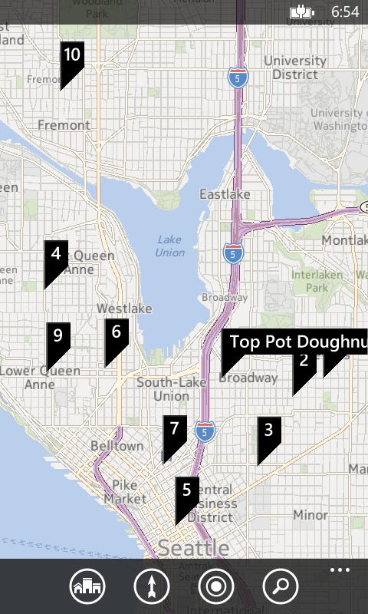
Built-In Map Tasks
MapTask
launch the map in 2 lines of code
MapsDirectionTask
start turn-by-turn directions in 4 lines of code
MapsDownloaderTask
download map data for offline in 2 lines of code
Notes:
If, for whatever reason, we feel that it is best for the user to use the native mapping application, we can very easily accommodate tht. The Maps task launches the Maps application wih some very simple and helpful parameters. You can provide a search string that is used to find and mark locations on the map or wef can optionally specify a center point for the map that appears. If you do not specify the center, the user’s current location is used as the center. You can also specify the zoom level to use initially when the map appears.
By using Launchers, you help provide a consistent user experience throughout the Windows Phone platform.
MapsDirectionTask
If you do not specify one of Start or End it defaults missing parameter to your current location
Can also specify only the name of a location (but no coordinate) and it will automatically do a geocoding service lookup and display a selection list if multiple matches
MapsDownloaderTask
Use the map downloader task to enable users to download map data for offline use. The task launches the Maps settings application which allows the user to select a region of map data to download.

Slide 13
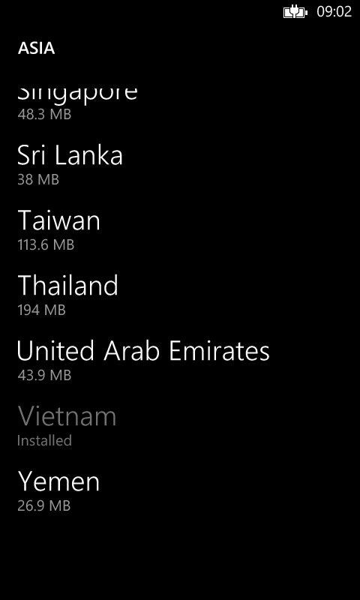
MapsDownloaderTask and Offline Maps
MapDownloaderTask mdt = new MapDownloaderTask();
mdt.Show();
Mapping offline in native and apps
Route Queries do not require a network
Notes:
I want to mention this quickly because it is one of my favourite features in Windows Phone 8. When we download a map to our phone, we can see that map both in the native code and inside our application. We require no network connectivity to find our own location.
Not only that, but can run a RouteQuery to fine a route between 2 or more points and, because we have the map downloaded, this query can run offline. So when we travel or we’re hiking, we can still use the map, find our way around and navigate in our application with ease.

Slide 14
Windows Phone 8 Sensors
Maps Demo
Location
Adding UI
Routing
Offline
Notes:
I’m going to opn up Visual Studio and show the code we would use to do this. Unfortunately, due to limitations in the emulator, I’m not going to be able to effectively demonstrate these capabilities.

Slide 15
Background Location Tracking
The code shown in this sample gets a new location whenever the Periodic agent runs
Every 30 minutes or so
Windows Phone 8 supports continuous background location tracking
Suitable for Run Tracking apps and Turn-by-Turn navigation

Slide 16
Windows Phone 8 Sensors
Notes:
Also new and exciting in Windows Phone 8 sensors are NFC and Bluetooth. I can hear you saying “Wait, didn’t Windows Phone 7 have Bluetooth?” Yes, it did but with Windows Phone 8, we’ve opened up Bluetooth to make it simple for developers to access it and interact with apps and devices using Bluetooth technology.

Slide 17
Near Field Communications
Near Field Communications provide a connection between devices that are very close together (within 3-4 centimetres)
Transfer of a message or byte stream from one device to another
An NFC connection can be used to configure a connection which is implemented using Bluetooth or WiFi
Notes:
Near Field Communication (NFC) is an international standard for short-range wireless connectivity that provides simple, and safe communication between electronic devices. NFC is the technology on the phone that makes Proximity scenarios possible.
NFC has the following key characteristics.
Communication occurs when devices are within 3–4 centimeters (1 to 1.5 inches) of each other.
Communication is highly selective and intentional because users are intentionally bringing their devices together to connect.
The maximum theoretical data transfer rate is 424 kbits/s. The typical data transfer rates range from 30 kbits/s to 60 kbits/s.
Communication also can occur between an NFC device and an unpowered NFC chip, or tag.

Slide 18
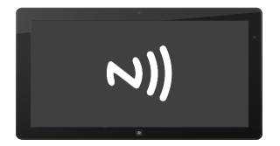
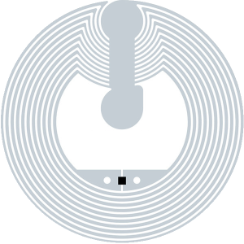
Near Field Communications Options
App to app
App to device
Tag to App
Notes:
Near Field Communication (NFC) is an international standard for short-range wireless connectivity that provides simple, and safe communication between electronic devices. NFC is the technology on the phone that makes Proximity scenarios possible.
NFC has the following key characteristics.
Communication occurs when devices are within 3–4 centimeters (1 to 1.5 inches) of each other.
Communication is highly selective and intentional because users are intentionally bringing their devices together to connect.
The maximum theoretical data transfer rate is 424 kbits/s. The typical data transfer rates range from 30 kbits/s to 60 kbits/s.
Communication also can occur between an NFC device and an unpowered NFC chip, or tag.

Slide 19
App to App communication
App to App communication allows two programs to interact using Bluetooth to exchange messages
The devices do not need to be paired in order to implement app to app connection
The ID_CAP_PROXIMITY capability must be enabled for the application
Notes:
In an App to App Bluetooth connection, your app searches for another instance of itself running on another device.
If your app finds another instance of itself, they can initiate a connection. When both apps accept the connection, a stream socket is opened between them, through which the app instances communicate.

Slide 20
Publishing Messages using NFC
ProximityDevice device = ProximityDevice.GetDefault();
// Make sure NFC is supported
if (device != null)
{
_device.DeviceArrived += device_DeviceArrived;
_device.SubscribeForMessage(“StringMessage", StringMessageHandler);
_device.SubscribeForMessage(“ByteMessage", ByteMessageHandler);
PeerFinder.Start();
}

Slide 21
Send Message When Device Arrives
void device_DeviceArrived(ProximityDevice sender)
{
if (sendingString)
{
sender.PublishMessage("MyStringMessage", someString);
}
else if (sendingBytes)
{
var messageWriter = new DataWriter();
messageWriter.UnicodeEncoding = UnicodeEncoding.Utf16LE;
messageWriter.WriteBytes(someBytes);
sender.PublishBinaryMessage("MyBinaryMessage", messageWriter.DetachBuffer());
}
}
Notes:
In an App to App Bluetooth connection, your app searches for another instance of itself running on another device.
If your app finds another instance of itself, they can initiate a connection. When both apps accept the connection, a stream socket is opened between them, through which the app instances communicate.

Slide 22
Receive String Message
private void StringMessageHandler(ProximityDevice sender, ProximityMessage message)
{
string messageRecieved = message.DataAsString;
}
Notes:
In an App to App Bluetooth connection, your app searches for another instance of itself running on another device.
If your app finds another instance of itself, they can initiate a connection. When both apps accept the connection, a stream socket is opened between them, through which the app instances communicate.

Slide 23
Receive Byte Message
private void ByteMessageHandler(ProximityDevice sender, ProximityMessage message)
{
byte[] messageBytes;
using (DataReader dReader = DataReader.FromBuffer(message.Data))
{
messageBytes = new byte[dReader.UnconsumedBufferLength];
dReader.ReadBytes(messageBytes);
}
}
Notes:
In an App to App Bluetooth connection, your app searches for another instance of itself running on another device.
If your app finds another instance of itself, they can initiate a connection. When both apps accept the connection, a stream socket is opened between them, through which the app instances communicate.

Slide 24
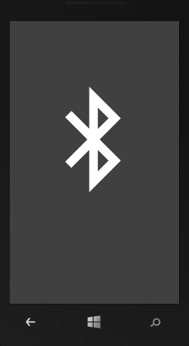
NFC socket connection to Bluetooth
Socket
Notes:
Bluetooth is a wireless communication technology through which devices within a 10-meter proximity can communicate with each other. Bluetooth establishes connections using a process called discovery/inquiry, in which devices can enumerate other devices within range that are in a discoverable state. Devices can then query the list of services that a particular device supports and ultimately establish connections to those services on the device. Using this technology, devices can communicate without a physical connection. Wireless headsets, remote control toys, and multiplayer games are examples of devices and apps that use Bluetooth technology.
Windows Phone 8 introduces an API that you can use to develop apps that communicate using Bluetooth to another app or to a device.

Slide 25
Setting up a StreamSocket using NFC
ProximityDevice device = ProximityDevice.GetDefault();
// Make sure NFC is supported
if (device != null)
{
PeerFinder.TriggeredConnectionStateChanged += OnTriggeredConnectionStateChanged;
// Start finding peer apps, while making app discoverable by peers
PeerFinder.Start();
}
The PeerFinder class allows an application to bind to an event fired when another application attempts to set up connection with this device

Slide 26
Setting up a StreamSocket using NFC
void OnTriggeredConnectionStateChanged(object sender, TriggeredConnectionStateChangedEventArgs args) {
switch (args.State) {
case TriggeredConnectState.Listening: // Connecting as host
break;
case TriggeredConnectState.PeerFound: // Proximity gesture is complete – setting up link
break;
case TriggeredConnectState.Connecting: // Connecting as a client
break;
case TriggeredConnectState.Completed: // Connection completed, get the socket
streamSocket = args.Socket;
break;
case TriggeredConnectState.Canceled: // ongoing connection canceled
break;
case TriggeredConnectState.Failed: // Connection was unsuccessful
break;
}
}
The event arguments contain a state change message

Slide 27
Using the connection
PeerFinder.AllowBluetooth = true;
PeerFinder.AllowInfrastructure = true;
The StreamSocket will be created using WiFi or Bluetooth to transfer the data
An application can configure the networking technologies by setting these properties
They are both set to true by default

Slide 28
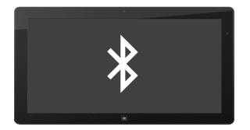
Blutooth Options
There are two Bluetooth communication scenarios supported by Windows Phone
App to app
App to device
No pairing required
Pairing required
Notes:
Windows Phone 8 supports two Bluetooth scenarios: app to app, and app to device. In each scenario a StreamSocket connection is established between the apps or devices.
App to device
In app-to-device communication, an app uses Bluetooth to discover a device that is offering a service that the app wants to access. If it finds a device within range that offers the service, the app initiates a connection request. When both accept the connection, a stream socket is opened between them, through which the app and the device communicate.
App to app
In app-to-app communication, an app uses Bluetooth to discover another app that is advertising a service that the app wants to access. If the app finds another app within range that offers the service, the app initiates a connection request. When both apps accept the connection, a stream socket is opened between them, through which the apps communicate.

Slide 29
Interacting with Remote Devices via Bluetooth
The Bluetooth discovery and connection methods provide the raw ability to transfer data between the devices using the StreamSocket
The application will have to implement the communications protocol that is required for a particular device
Notes:
Once you have your StreamSocket, you use this to communicate with the service on the remote device.
It’s up to you to implement the communications protocol the service on the device is expecting.

Slide 30
Windows Phone 8 Sensors
Notes:
Keynote (overall pitch both on the platform, consumer, design and opportunity) – 60 mins

Slide 31
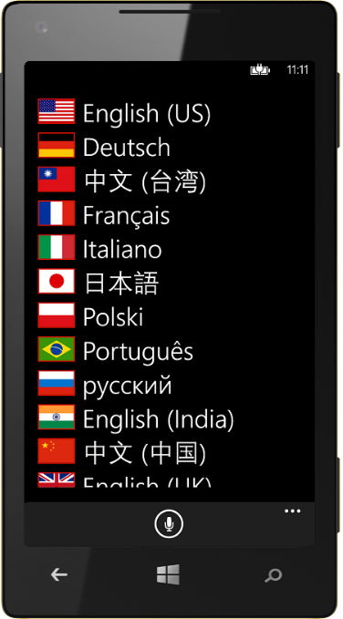
Windows Phone 8 Sensors
15 supported languages
Multiples voices per language
Notes:
Keynote (overall pitch both on the platform, consumer, design and opportunity) – 60 mins

Slide 32
Windows Phone 8 Sensors
Speech Synthesis (Text to Speech)
Voice Commands
Speech to text
Notes:
Keynote (overall pitch both on the platform, consumer, design and opportunity) – 60 mins

Slide 33
Speech Synthesis

Slide 34
Simple Speech
async void CheeseLiker()
{
SpeechSynthesizer synth = new SpeechSynthesizer();
await synth.SpeakTextAsync("I like cheese.");
}
The SpeechSynthesizer class provides a simple way to produce speech
The SpeakTextAsync method speaks the content of the string using the default voice
Notes:
The quickest and easiest way to generate speech output to a user of your app is to provide a plain text string to the SpeechSynthesizer.SpeakTextAsync() method. The code example shows how to do this.
Note that this is one of the APIs that uses the new Task-based async programming pattern.

Slide 35
Speech Synthesis And Language Support
Set SpeechSynthesizer to different language
foreach (VoiceInformation vi in InstalledVoices.All)
{
if (vi.Language == "de-DE")
{
_speechSynth = new SpeechSynthesizer();
_speechSynth.SetVoice(vi);
}
}
Notes:
You can adjust settings of the speech recognizer that control how it responds to the absence of input or to the absence of recognizable input when speech is expected. These settings affect how recognition behaves while waiting for expected speech input at the onset or the conclusion of a speech recognition operation.
InitialSilenceTimeout - adjust the value for the InitialSilenceTimeout setting to have more or less time elapse while your application waits for a user to begin speaking after a recognition operation has started.
BabbleTimeout - The time interval during which the speech recognizer will continue to listen while it receives only non-speech input such as background noise. Background noise includes any non-speech input that does not match any active rule in the grammars currently loaded and activated by the speech recognizer.
EndSilenceTimeout - The time interval during which the speech recognizer will wait to finalize the recognition operation, after speech has finished and only silence is being received as input.

Slide 36
Voice Commands

Slide 37
Application Launching using Voice command
The Voice Command feature of Windows Phone 7 allowed users to start applications
In Windows Phone 8 the feature has been expanded to allow the user to request data from the application in the start command
The data will allow a particular application page to be selected when the program starts and can also pass request information to that page
Notes:
In Windows Phone 7.x, users can already launch into your app by pressing and holding down the Windows key and then saying "Start" or "Open" followed by the name of your app. In Windows Phone 8, you can extend and customize additional phrases that a user can say, passing in parameters to your app, and giving users rapid access to your app’s functionality. This allows users to:
Launch to a specific page in an app. For example, a user can press the Start button and speak "Start MyApp, navigate to MyPage" or simply "Start MyApp go to MyPage."
Launch an app and initiate an action. For example, a user can press the Start button and speak "Start MyApp Show MyItem" (where MyItem could be app-specific data such as an item in a favorites list).
A user using the Contoso Widgets app could press the Start button and say "Contoso Widgets, show best sellers" to both launch the Contoso Widgets app and navigate to a 'best sellers' page, or some other action that the developer specifies.
To use voice commands, you must :
Create a Voice Command Definition (VCD) file. This is an XML document that defines all the spoken commands that users can say to initiate actions when launching your app.
Add code to initialize the VCD file with the phone's speech feature.
Add code to handle navigation and to execute commands.

Slide 38
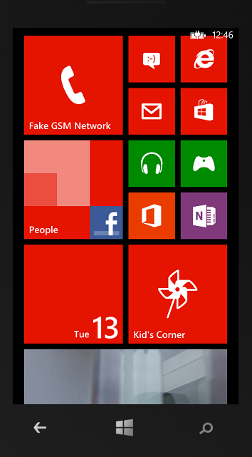
Voice Command Query
“Fortune Teller, Will I find gold?”
Phone displays
“Showing gold”
/Money.xaml/?voiceCommandName=showMoney&futureMoney=gold&reco=Fortune%20Teller%Will%20I%20find%20gold"
Notes:
Using the Fortune Teller commands, this means that if a user speaks "Fortune Teller, Will I find gold?", the app will be launched at the page /Money.xaml with a Query String that contains the string shown.
Notice that the variable elements such as the phrase from a phrase list are listed separately, as well as the whole recognized phrase.

Slide 39
Voice Command Query
/Money.xaml/
?voiceCommandName=showMoney
&futureMoney=gold
&reco=Fortune%20Teller%Will%20I%20find%20gold
Command Name
Phaselist Name
Recognized phrase
Whole phrase as it was recognized
Notes:
Using the Fortune Teller commands, this means that if a user speaks "Fortune Teller, Will I find gold?", the app will be launched at the page /Money.xaml with a Query String that contains the string shown.
Notice that the variable elements such as the phrase from a phrase list are listed separately, as well as the whole recognized phrase.

Slide 40
Simple Speech Input

Slide 41
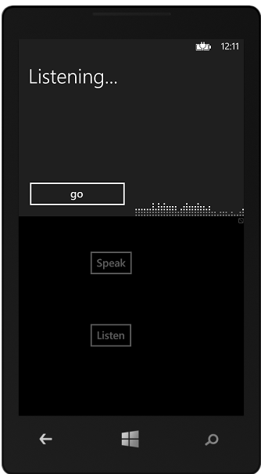
Recognizing Free Speech
A Windows Phone application can recognise words and phrases and pass them to your program
The standard “Listening” interface is displayed over your application
Notes:
Speech recognition can be a natural, efficient, and accurate way for users to interact with applications in Windows Phone 8.
To support speech recognition, Windows Phone 8 includes a speech runtime, recognition APIs for programming the runtime, ready-to-use grammars for dictation and web search, and a graphical user interface (GUI) that helps users discover and use speech recognition features.

Slide 42
Simple Speech Recognition
SpeechRecognizerUI recoWithUI;
async private void ListenButton_Click(object sender, RoutedEventArgs e)
{
this.recoWithUI = new SpeechRecognizerUI();
SpeechRecognitionUIResult recoResult =
await recoWithUI.RecognizeWithUIAsync();
if ( recoResult.ResultStatus == SpeechRecognitionUIStatus.Succeeded )
MessageBox.Show(string.Format("You said {0}.",
recoResult.RecognitionResult.Text));
}
The above method checks for a successful response
By default the system uses the language settings on the Phone
Notes:
The quickest and easiest way to enable your application for speech recognition is to use the built–in dictation grammar included with Windows Phone 8.
The dictation grammar will recognize most words and short phrases in a language, and is activated by default when a speech recognizer object is instantiated.
Using the built in dictation grammar, you can enable speech recognition with just a few lines of code, as in this example.

Slide 43
Speech Recognition And Language Support
Set SpeechRecognizerUI to different language
foreach(SpeechRecognizerInformation sri
in InstalledSpeechRecognizers.All)
{
if(sri.Language == "de-DE")
_speechRecognizer.Recognizer.SetRecognizer(sri);
}
Notes:
You can adjust settings of the speech recognizer that control how it responds to the absence of input or to the absence of recognizable input when speech is expected. These settings affect how recognition behaves while waiting for expected speech input at the onset or the conclusion of a speech recognition operation.
InitialSilenceTimeout - adjust the value for the InitialSilenceTimeout setting to have more or less time elapse while your application waits for a user to begin speaking after a recognition operation has started.
BabbleTimeout - The time interval during which the speech recognizer will continue to listen while it receives only non-speech input such as background noise. Background noise includes any non-speech input that does not match any active rule in the grammars currently loaded and activated by the speech recognizer.
EndSilenceTimeout - The time interval during which the speech recognizer will wait to finalize the recognition operation, after speech has finished and only silence is being received as input.

Slide 44
Windows Phone 8 Sensors
Matthias Shapiro
mashapir@microsoft.com
http://matthiasshapiro.com

