Slide 1
I Once Was Blind BuiLding an Info ViZ that Means Something
Notes:
Hello and welcome to my presentation, I Once Was Blind: Building an Information Visualization that Means Something. This is a topic that I get very excited about because, thanks to computers, we now have gobs and gobs of knowledge, but there is a problem with this knowledge. Knowledge is not the same as understanding.

Slide 2
Knowledge
Notes:
This is the stimulus bill. It’s really just a database of who gets how much money. But can anyone tell me how much of the stimulus is going to highways and bridges? Hint… it’s right here. Tons of information… zero understanding.

Slide 3
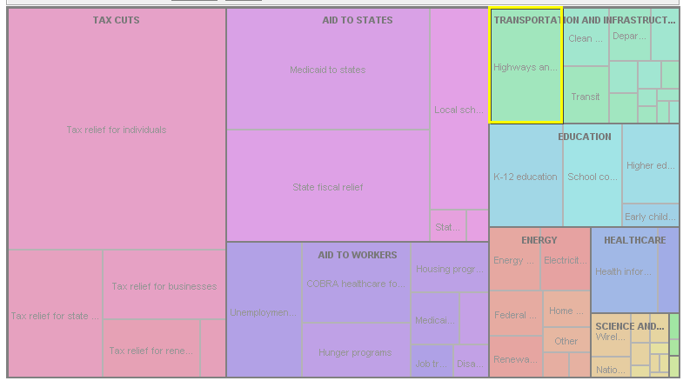
UNDERSTANDING
Notes:
This is that same information, but in visual form. I can actually drill into this visualization and see that the highways chunk is $30 billion. But now I know at a glance how that compares to the rest of the bill. Information visualization takes knowledge and turns it into understanding. So what steps do you need to take to make your own visualizations?

Slide 4
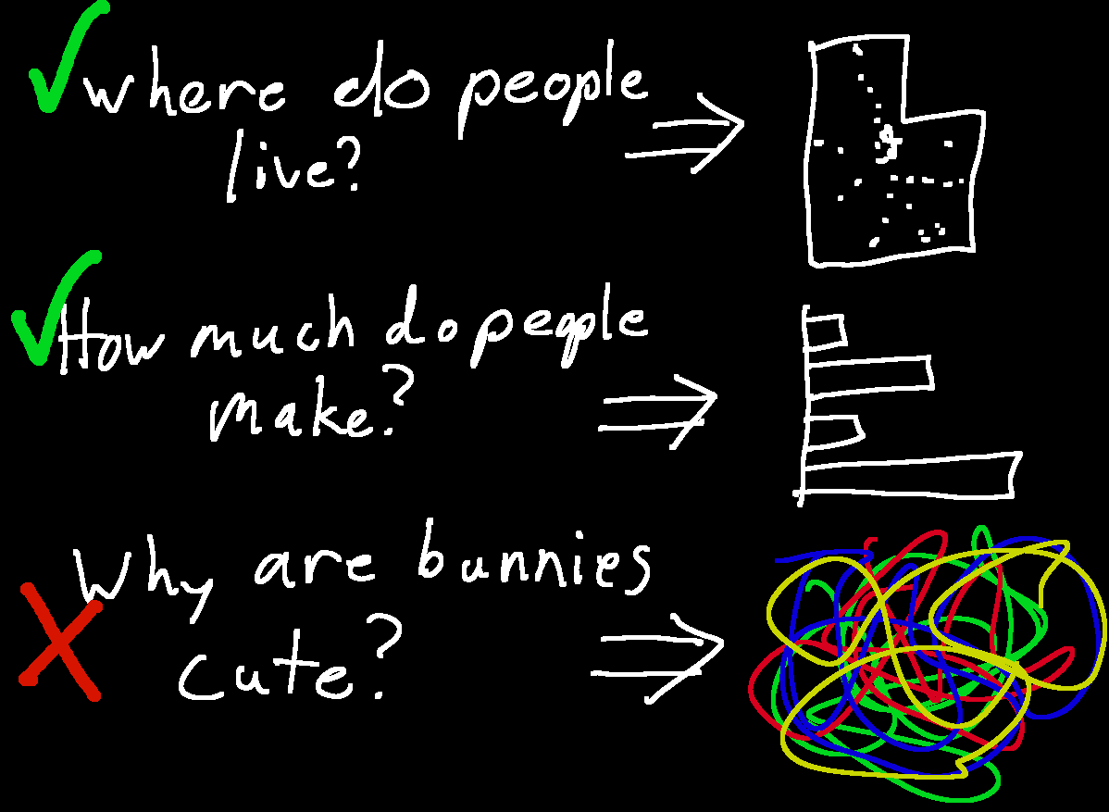
INFO VIZ IN THREE EASY STEPS
Ask a specific question
Notes:
First, find a question you want to ask. You question should be very specific to some kind of information. Include words like “How much” “How often” “Where”, or “When”. Your ultimate goal with your question is to use the picture to tell a story like… How many soldiers did Napoleon lose on his march to Moscow?

Slide 5
Your Goal Is To Tell A Story
Example: How many men did Napoleon lose in his march to Moscow?
Notes:
This is a graph that answers that question. The large tan chunk at the beginning is the French army when they left and we can see them shrinking, shrinking on the way there, shrinking, shrinking on the way back until they are only a tiny slice of the original army. Instead of using numbers, we can see the scale of loss.

Slide 6
INFO VIZ IN THREE EASY STEPS
Ask a specific question
Gather the information
Notes:
Once you have a good question, you need to gather your data. But remember that you only want data that applies to your story. If you gather too much data, you’re going to have a very convoluted story.

Slide 7
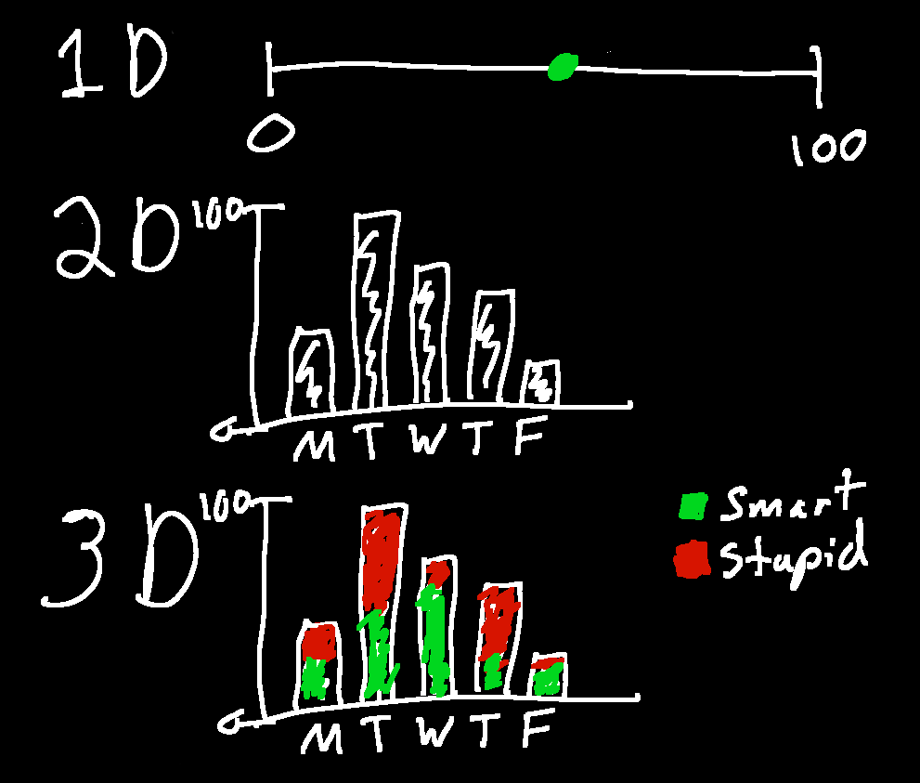
Rule Of Thumb: Use 3 Dimensions (Or Less) Of Information
Notes:
For me, it is helpful to think of my question in terms of dimensions. We can’t see in more than three dimensions and we can’t quickly process visual information in more than three dimensions either. The more types of data we have, the more difficult it is to understand the real meaning. Not saying it can’t be done, but it’s hard.

Slide 8
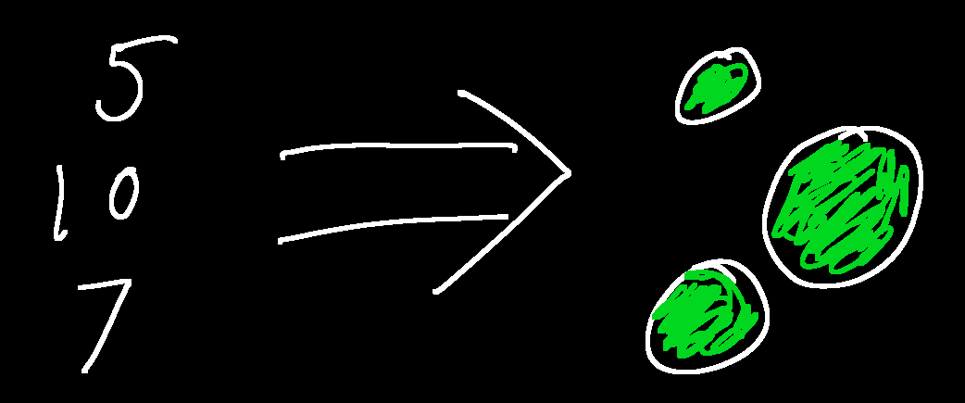
INFO VIZ IN THREE EASY STEPS
Ask a specific question
Gather your information
Apply a metric
Notes:
Next, you’ll apply a metric. The metric translates the raw data into a visually meaningful statement. Here is probably the most common one, size. Bigger numbers are represented by bigger circles. Easy and quickly understood.

Slide 9
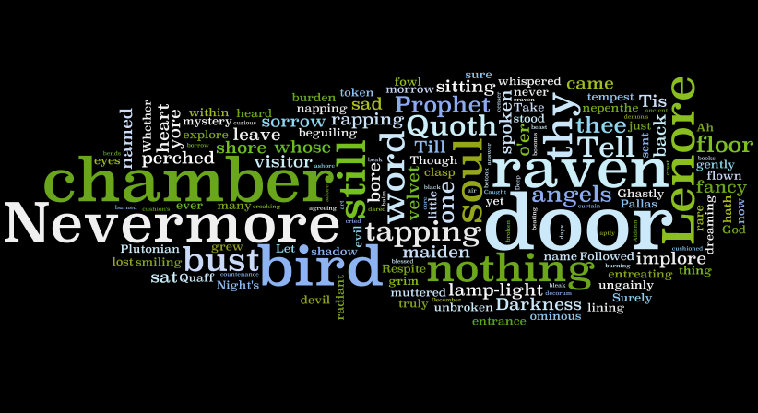
SIZE
COLOR
LOCATION
NETWORKS
TIME
Notes:
This is Edgar Allen Poe’s “The Raven” visualized so that more common words are larger. While size can be huge impact, remember that every painful bar graph you’ve ever seen is someone assuming that all data can be visualized via size.

Slide 10
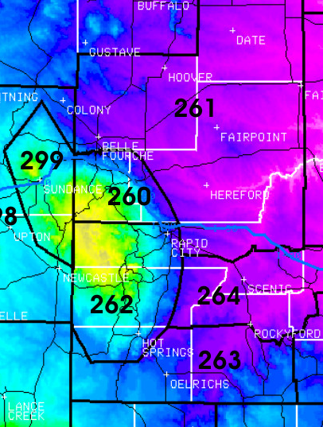
SIZE
COLOR
LOCATION
NETWORKS
TIME
Notes:
A color metric is when the information is aligned along a color continuum. Because we perceive variations in color to a fine degree of detail and because color can give us an instant impression of the information, color is ideal for huge sets of data.

Slide 11
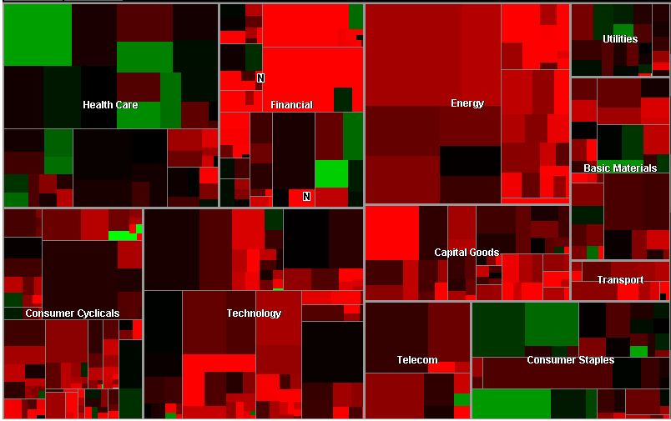
Notes:
This map of the stock market hardly needs any explanation if you’re not red-green color blind. We can instantly see which sectors are doing well and which are hurting. We can also quickly identify exceptions to the rule.

Slide 12
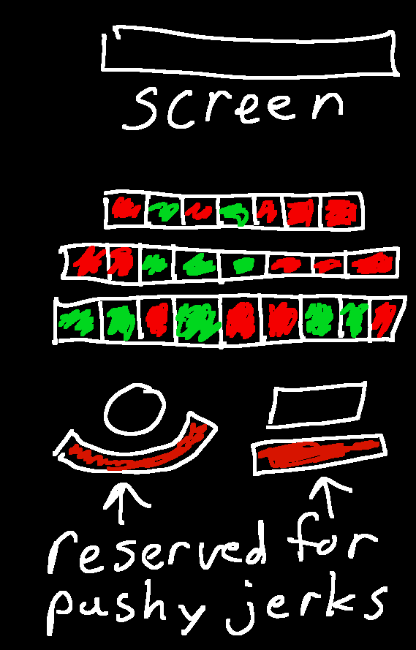
SIZE
COLOR
LOCATION
NETWORKS
TIME
Notes:
The location metric maps information against physical locations. Maps are an obvious example, but if you’ve ever picked seats in a theater or on an airplane, you’ve probably seen a location visualization. Ignore my social commentary about Brewvies here… it was late and I was tired.

Slide 13
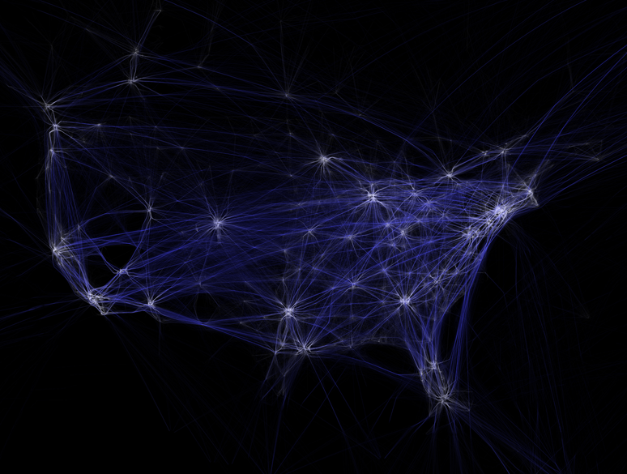
Notes:
This is a map of flight data in a 24 hour period. It combines location data with the altitude data (higher is darker, lower is lighter) in such a way that we can quickly see all the flight hubs and flight patterns in the country.

Slide 14
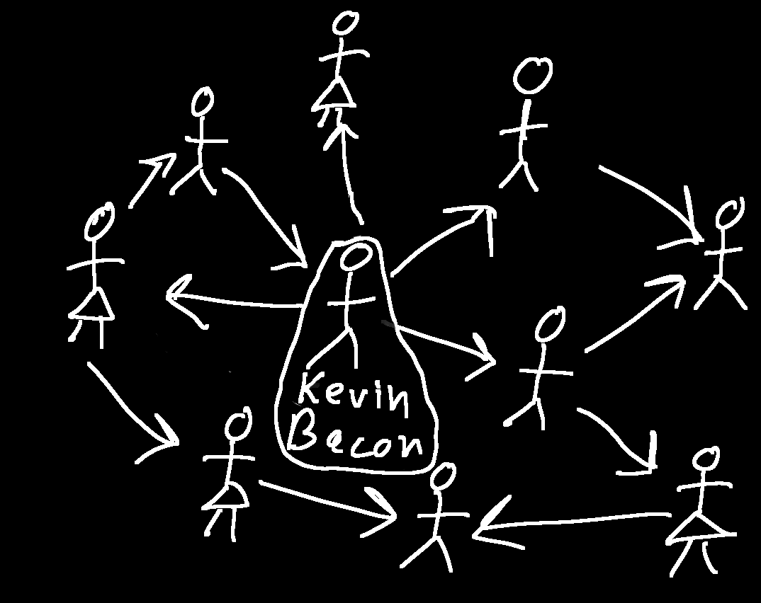
SIZE
COLOR
LOCATION
NETWORKS
TIME
Notes:
The network metric shows connections between data points. This is really valuable for seeing highly connected groups and trends out of individual points. Networks can be fascinating to look at, but when you get up to more than 100 points, it starts getting hard to see patterns.

Slide 15
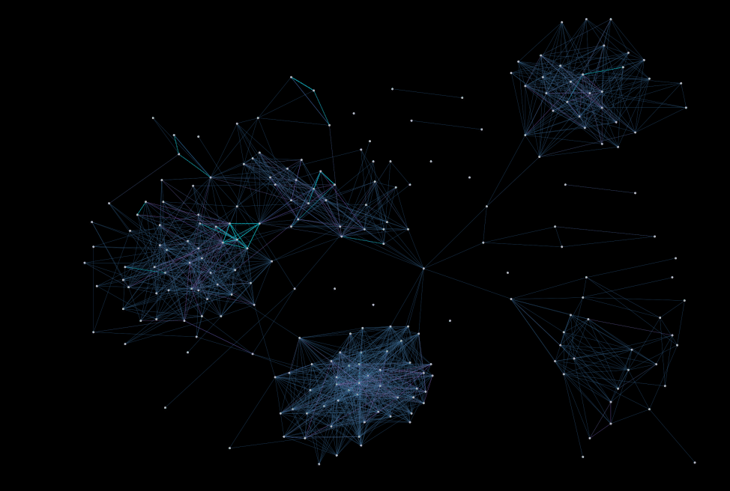
Notes:
This is a network visualization of my Facebook friends. We can instantly see that I have five clusters that correspond to my friends (starting at the top-right) grad school, Utah, summer camp, undergrad and high school.

Slide 16
SIZE
COLOR
LOCATION
NETWORKS
TIME
Notes:
Lastly the time metric visualizes data as it changes over time. Every timeline you’ve seen uses this metric, and most animated visualizations show how the data changes over time, which can also be considered another way of visualizing time… by mapping it to time.

Slide 17
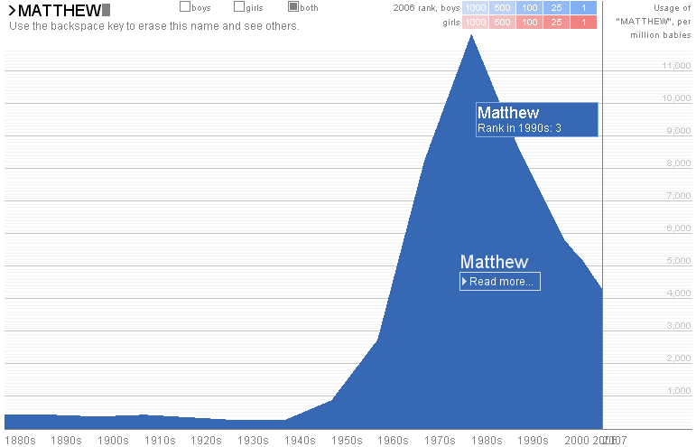
Notes:
Here we see the popularity of the name Matthew putter around in the early part of the century until all of the sudden surge from the 70s to the 90s, explaining my sudden urge to change my name from “Matt” to “Matthias” when I went to college. Finally, always keep in mind that every good visualization is telling a story.

Slide 18
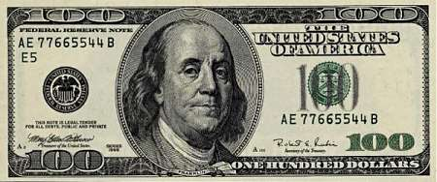
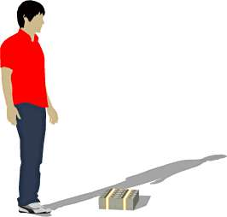
Above All Tell a Story
Notes:
So, let’s try this out and tell a story that answers the question: How much is a trillion dollars? Here we have $100 dollars. Bundle a bunch of these suckers into a package and you get $10 grand. Grab enough piles to fit into my gym bag and you have $1 million.

Slide 19
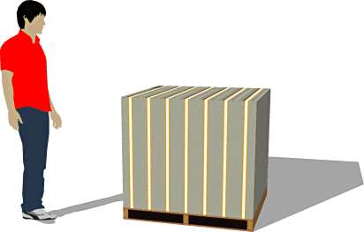
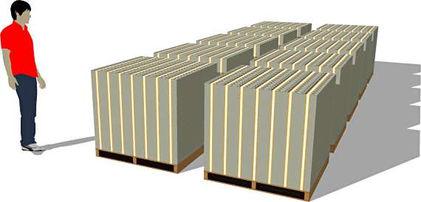
Notes:
If you get enough of those piles to need a forklift, you’re looking at $100 million dollars. Fill a small storage unit with cash and you could have $1 billion dollars. And, as the saying goes, a billion here, a billion there and pretty soon you’re looking at some real money…

Slide 20
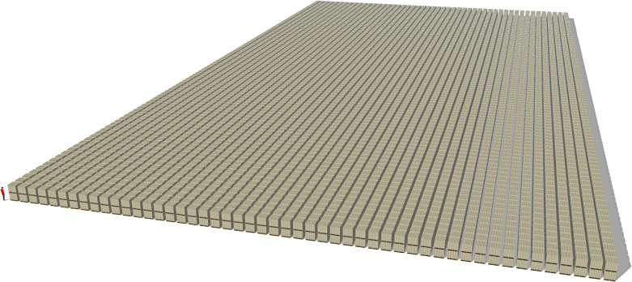
For more on visualizations:
http://www.designerwpf.com
Notes:
A trillion dollars. Thanks for your time. If you’re interested in any of the visualizations you’ve seen here, you can visit my blog “Designer WPF”, where I’ll have links to them all.

