Slide 1
Windows Phone 8 More Than An App
Matthias Shapiro
Twitter
@matthiasshap
Email
mashapir@microsoft.com
Blog
http://matthiasshapiro.com
Notes:
Welcome to Windows Phone 8, more than an app. (need more of an introduction)

Slide 2
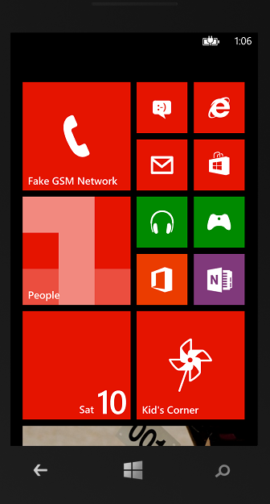
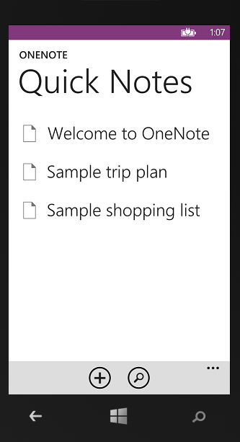
Notes:
Usually when we think about applications we think about the application as it exists when the user first opens it. In that situation, it is running in the foreground with all the capabilities and functionality that you would expect from a cutting edge mobile platform.
But we should keep in mind that Windows Phone gives us a number of ways to bring our app to the user outside the usual foreground scenario. We as developers have the ability to integrate our application into Windows Phone that our app can be more than just an app… it can become an extension of the Phone’s Native capabilities.

Slide 3
Live Tiles
Lock Screen
Push Notifications
Lenses
Notes:
But we should keep in mind that Windows Phone gives us a number of ways to bring our app to the user outside the usual foreground scenario. We as developers have the ability to integrate our application into Windows Phone that our app can be more than just an app… it can become an extension of the Phone’s Native capabilities.

Slide 4
Windows Phone 8 – More Than An App
Points of integration (with demos)
Live Tiles
Lock Screen Notifications
Lenses
Notes:
There are actually so many points at which we can integrate with Windows Phone that it is impossible to touch on all of them in a singe hour presentation. But in this session we will cover the newest and most exciting features in Windows Phone 8 along with some practical examples of how to implement these features.
We’ll cover Live Tiles and the new ability to create tiles that more closely integrate with the tile style of native applications. We’ll cover the Lock Screen notifications that allow our app to send numbered notifications that will show up evern when the phone is locked, similar to the notifications we see from messaging, email and telephone.
Then we’ll look at Lenses, which allows developers to extend the capabilities of the native camera application.

Slide 5
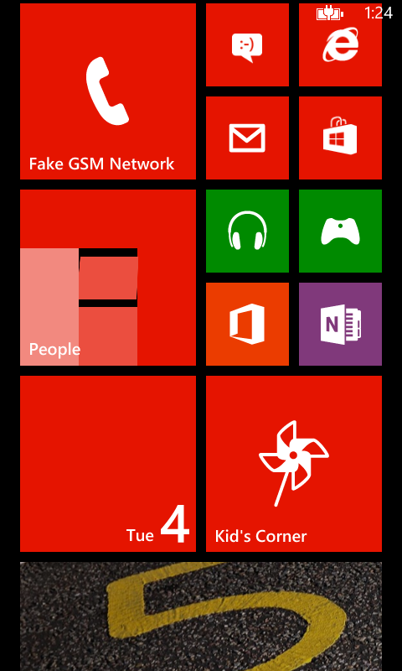
Tiles on Windows Phone 8
Notes:
First, let’s talk about the most visible, most fun Windows Phone integration point… the Tiles.

Slide 6
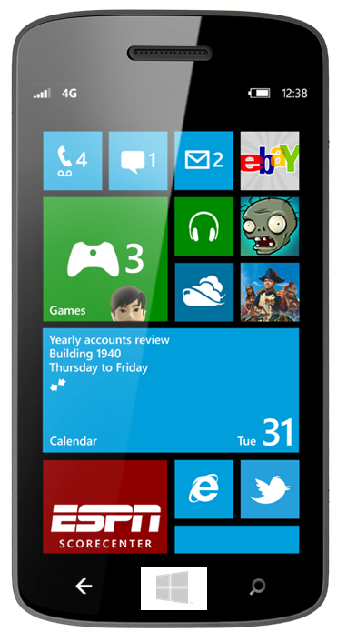
Live Tiles on Windows Phone
Glance, Know, Go
Update from push notification
Update from app (WP7.5 Mango)
Update on a schedule (WP8)
Notes:
The large tiles on the Start screen is a key differentiator for Windows Phone compared to the UI of other smartphone platforms. Windows Phone users love this ‘glance and go’ feature which enables them to look at their start screen, see what information has changed on the tiles and tap on a tile to launch the associated app. The start screen becomes a very personal reflection of what is important to that phones owner as users customize it to suit their own interests.
The tiles are known as ‘Live Tiles’ because the information on them updates, such as the number of missed calls, unread emails etc. In Windows Phone 7.0, developers could only update the Live Tile of their application by running code on a server which sent updates via MPNS (Microsoft Push Notifications Services). Push notifications is covered in a later module.
In Windows Phone 7.5 ‘Mango’, developers can now write code in their apps that uses the new Local Tiles API to create and update tiles directly from the app running on the phone. You can also run code to update tiles from background agents.

Slide 7
Live Tiles 101
Shortcuts to apps
Apps can create secondary tiles
Three tile sizes in Windows Phone 8
Three tile types in Windows Phone 8
7
Notes:
Live Tiles 101
A live tile is a shortcut to an app: when the user taps on it, the corresponding app opens.
The appearance of a tile can be static, or it can update to report changed information to the user.
There are two sizes, small and large. The double-width tiles are only available for use by the built-in experiences.
The only way that the main application tile for an app can be pinned to the start screen, is if the user taps and holds on the app from the programs menu, and then taps ‘Pin to Start’.
The user can tap and hold on any tile on the start screen to enable edit mode, were the user can reorder the start screen tiles, or delete a tile.

Slide 8
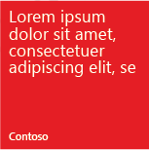
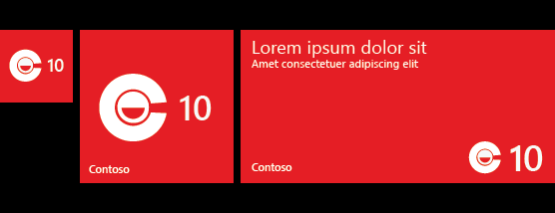
Tile Templates and Tile Sizes
Flip – flips from front to back
Iconic – clean iconic layout designed to reflect Windows Phone design principles
Cycle – cycles through up to nine images
8
Notes:
There are several things you can do with Tiles:
Support multiple sizes, customizable by your customer.
Choose from one of three visual templates to help your app stand out.
Offer a variety of secondary Tiles.
Control which page your customers land on when clicking on your secondary Tiles.
The Tile API wraps the OS Tile experience so 3rd party app developers have access to exactly the same tile functionality as the built-in apps.

Slide 9
Tile Content
 | Tile Size | Flip and Cycle Images | Iconic Images
Small | 159 x 159 pixels | 159 x 159 pixels | 110 x 110 pixels
Medium | 336 x 336 pixels | 336 x 336 pixels | 202 x 202 pixels
Wide | 691 x 336 pixels | 691 x 336 pixels | N/A
9
Notes:
These sizes are automaticall scaled for the other screen resolutions

Slide 10
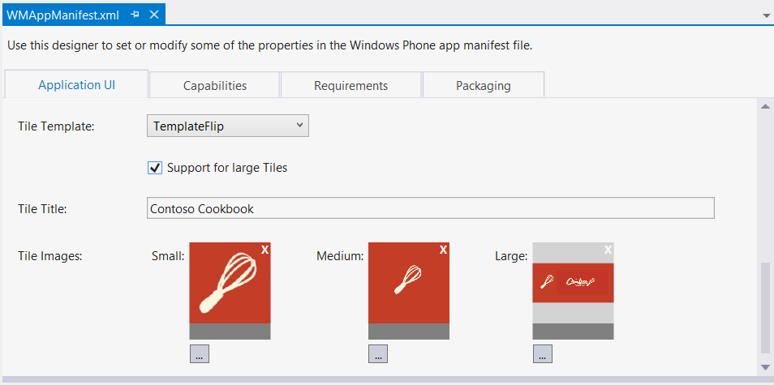
Defining the Application Tile in the Application Manifest
Double-click WMAppManifest.xml to open using the new Manifest Editor
On the Application UI tab, set the Tile Template, optional Title and Tile Images

Slide 11
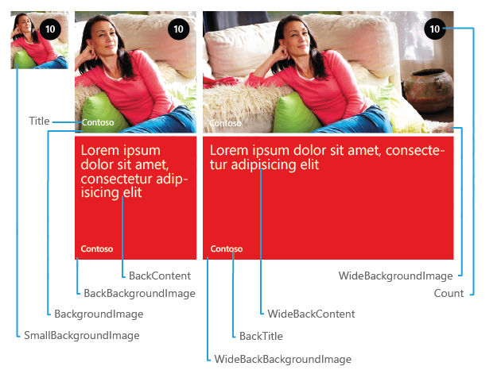
Flip Tile Template
Flips from front to back
Small size does not flip
Medium size is the same as the WP7.1 tile template
Set as many tiles as you want (must go to different URIs)

Slide 12
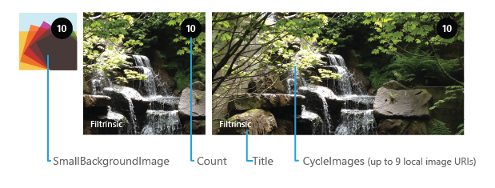
Cycle Tile Template
Cycles between from 1 to 9 images
Small tile does not cycle

Slide 13
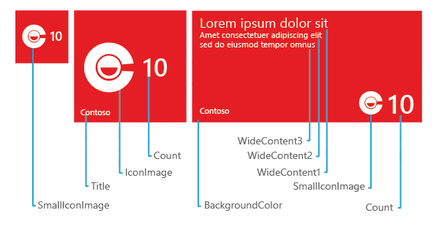
Iconic Tile Template
Displays a small image in the center of the Tile and is designed to reflect Windows Phone design principles

Slide 14
Tiles Demo
Notes:
First, let’s talk about the most visible, most fun Windows Phone integration point… the Tiles.

Slide 15
Updating Tiles with a Tile Schedule
Periodically updates the tile image without pushing message though
Updates images only from the web, not from the app local store
Update recurrence can by Onetime, EveryHour, EveryDay, EveryWeek or EveryMonth
Notes:
Tile Schedule
Another way to update the background image on the front of the Application Tile or secondary Tiles is to create a ShellTileSchedule:
ShellTileSchedule APIs–
The background images on the front of a Tile can be updated on a recurring schedule, even if your application is not running. The URI of the update background image must be a RemoteURI. The maximum allowed size of the Tile background image is 80 KB. The maximum allowed download time is 30 seconds. If these limits are exceeded, the schedule will be removed after three consecutive failures.

Slide 16
Limitations of a Tile Schedule
Can only update the image on the front of the tile
Updates images only from the web, not from the app local store
Image size must be less than 150 KB (up from 80KB in WP7.1)
Download time must not exceed 45 seconds (down from 60 seconds in 7.1)
Lowest update time resolution is 60 minutes
If the schedule for an indefinite or finite number of updates fails too many times, OS will cancel it
Notes:
Tile Schedule
Another way to update the background image on the front of the Application Tile or secondary Tiles is to create a ShellTileSchedule:
ShellTileSchedule APIs–
The background images on the front of a Tile can be updated on a recurring schedule, even if your application is not running. The URI of the update background image must be a RemoteURI. The maximum allowed size of the Tile background image is 80 KB. The maximum allowed download time is 30 seconds. If these limits are exceeded, the schedule will be removed after three consecutive failures.

Slide 17
Tiles on Windows Phone 8
3 Tile Sizes – small, medium and wide
3 Tile Types – Flip, Cycle, Icon
Tile Updates with scheduled updates and push notifications (not shown)
Notes:
First, let’s talk about the most visible, most fun Windows Phone integration point… the Tiles.

Slide 18
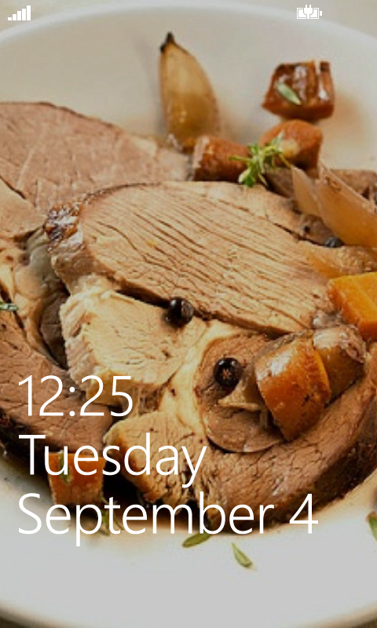
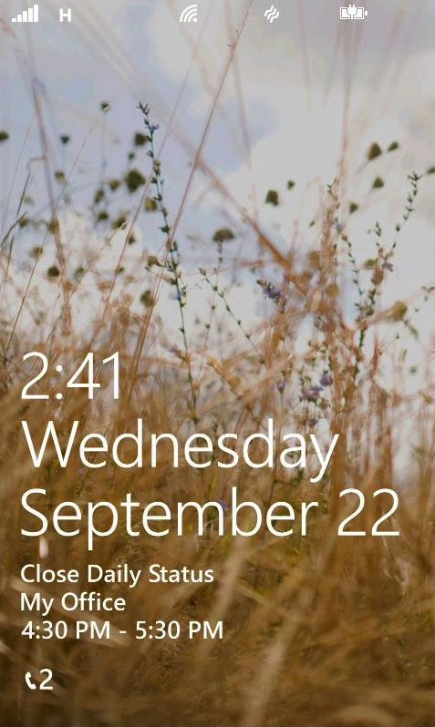
Lock screen notifications on Windows Phone

Slide 19
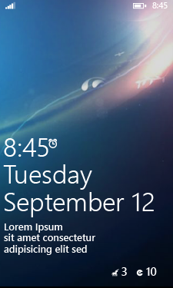
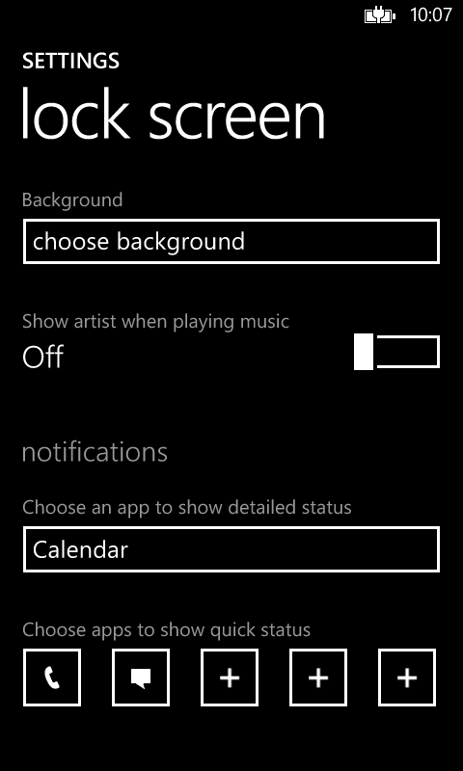
Lock Screen on Windows Phone 8
End user can now select any app that has been enabled for lock screen notifications to show detailed status
Select any five apps to show quick status (icon and count)
For your app to be included in the notifications area, all you have to do is
Create an icon
Declare the app’s intent in the application manifest file

Slide 20
Creating a lock screen icon
Create a 30 x 30 pixel PNG image that will be used to identify your app on the lock screen
Contain only white pixels and transparent background
Default name is LockIcon.png
Use this name and you do not have to explicitly declare it in the application manifest

Slide 21
How to Update the Icon Count and Text
Lock Screen Icon Count and Text is taken directly from your applications primary tile
Secondary tiles are not used for this feature
Information is only displayed on the lock screen if the tile contains the information
For example, a count will only be displayed if the tile displays it
Primary tile does not need to be pinned to the Start Screen for lock screen notifications to be enabled
Update Primary Tile content in the usual way
Local Shell Tiles API
Push Notifications

Slide 22
Lock screen notifications on Windows Phone (demo)

Slide 23
Lock Screen Background

Slide 24
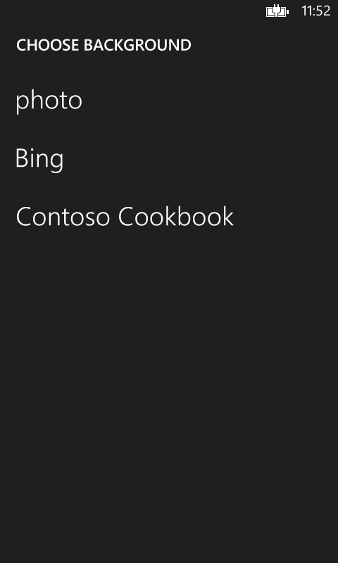
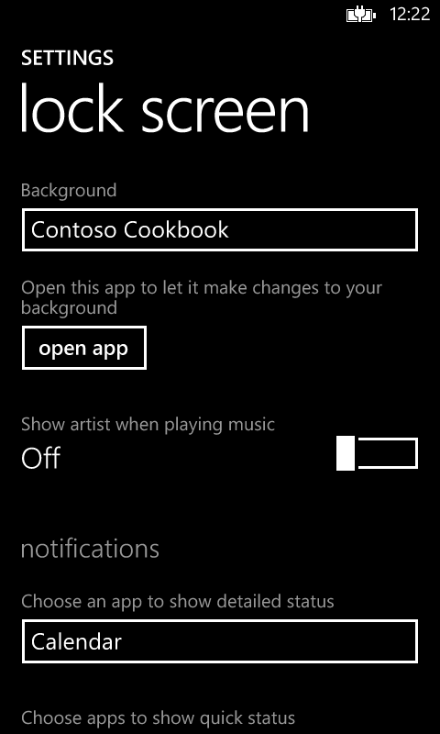
Lock Screen Background on Windows Phone 8
End user can choose a background image from their own photos or search for an image on Bing
In addition, they can choose an app to be the background image provider
For your app to be a lock screen background provider, all you have to do is
Declare the app’s intent in the application manifest file
Write code to change the background image

Slide 25
Adding the Lock Screen Background Extension
Open your WMAppManifest.xml file and add the extension
<Extension ExtensionName="LockScreen_Background"
ConsumerID="{111DFF24-AA15-4A96-8006-2BFF8122084F"
TaskID="_default" />
Notes:
Thought: Netflix changes your homescreen to the poster of the last movie you watched.

Slide 26
Accessing Your Image
To use an image that you shipped in your app, use ms-appx:///
Uri imageUri = new Uri("ms-appx:///background1.png", UriKind.RelativeOrAbsolute); LockScreen.SetImageUri(imageUri);
To use an image stored in the Local Folder, use ms-appdata:///local/
Uri imageUri = new Uri("ms-appdata:///local/background2.png", UriKind.RelativeOrAbsolute); LockScreen.SetImageUri(imageUri);
Notes:
Thought: Netflix changes your homescreen to the poster of the last movie you watched.

Slide 27
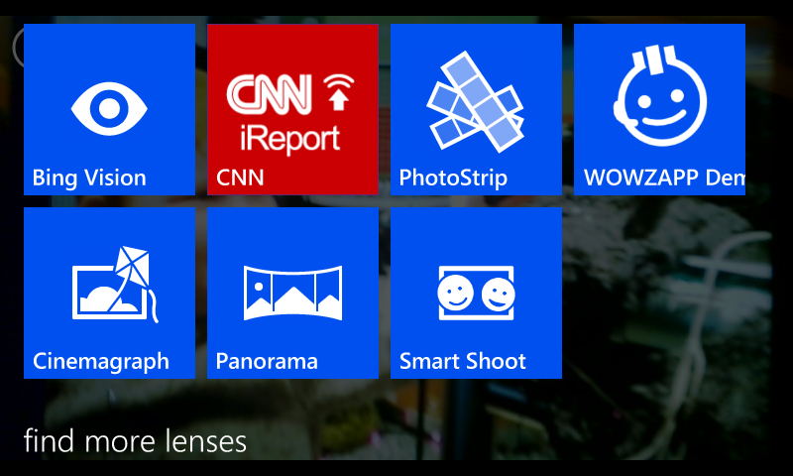
Lenses

Slide 28
Lenses
Add Camera functionality (barcode scanning, augmented reality)
Submit Images to Custom Source (Twitter, Flickr, 500px)
Anything you want!

Slide 29
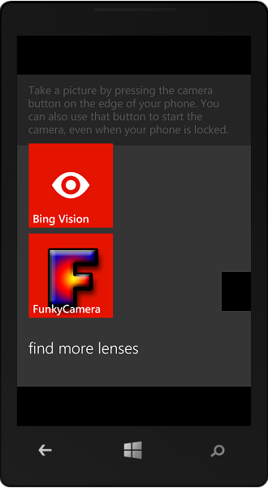
Creating a Lens
A Lens is a custom camera application which can be accessed from within the camera application
An application is flagged as a Lens application by setting a flag in the manifest and providing icons that can be used to browse for the Lens when the camera is in use

Slide 30
Creating a Lens application
<Extensions>
<Extension ExtensionName="Camera_Capture_App"
ConsumerID="{5B04B775-356B-4AA0-AAF8-6491FFEA5631}"
TaskID="_default" />
</Extensions>
This text must be added to the WMAppManifest.xml file for the application, just after the <Tokens> section
There is no GUI for this alteration, you have to edit the XML directly
Notes:
Explain that the viewfinderBrush in here is assigned to the camera by the call of SetSource in the method that sets up the camera.

Slide 31
Adding the Lens Icons
Three Icons are required, one for each Windows Phone screen size
WVGA 173 × 173 Assets\Lens.Screen-WVGA.png
720p 259 × 259 Assets\Lens.Screen-720p.png
WXGA 277 × 277 Assets\Lens.Screen-WXGA.png
They are all placed in the Assets folder of the application
Use a transparent background to match the Windows Phone color scheme

Slide 32
Lenses Demo

Slide 33
Creating an Auto-Uploader for photos
<Extensions>
<Extension ExtensionName="Photos_Auto_Upload"
ConsumerID="{5B04B775-356B-4AA0-AAF8-6491FFEA5632}"
TaskID="_default" />
</Extensions>
You can also create an application that has an auto-upload behaviour for pictures that the user may take
The upload behaviour is a “resource intensive” background task
The application must set the extension shown above and display a settings page where the user can set authentication and upload options
This is a background process and therefore might not get to run
Notes:
Think if this as really a way of getting your application into the Upload Settings page. The way I see it, it doesn’t give the program any special access to the camera roll, it just provides a way that you can get the user settings and store them. When (if) the background task is started it must look in the camera roll and find files to be uploaded. There is nothing in this registration that gets you access to the picture stream or notification of when pictures have been taken.

Slide 34
Even More Ways To Integrate
Bing Search
Windows Phone Store
Music Hub
Launchers / Choosers
Notes:
Usually when we think about applications we think about the application as it exists when the user first opens it. In that situation, it is running in the foreground with all the capabilities and functionality that you would expect from a cutting edge mobile platform.
But we should keep in mind that Windows Phone gives us a number of ways to bring our app to the user outside the usual foreground scenario. We as developers have the ability to integrate our application into Windows Phone that our app can be more than just an app… it can become an extension of the Phone’s Native capabilities.

Slide 35
Even More Ways To Integrate
Wallet
Push Notifications
File Association
Notes:
Usually when we think about applications we think about the application as it exists when the user first opens it. In that situation, it is running in the foreground with all the capabilities and functionality that you would expect from a cutting edge mobile platform.
But we should keep in mind that Windows Phone gives us a number of ways to bring our app to the user outside the usual foreground scenario. We as developers have the ability to integrate our application into Windows Phone that our app can be more than just an app… it can become an extension of the Phone’s Native capabilities.

Slide 36
Windows Phone 8 More Than An App
Matthias Shapiro
Twitter
@matthiasshap
Email
mashapir@microsoft.com
Blog
http://matthiasshapiro.com
Notes:
Welcome to Windows Phone 8, more than an app. (need more of an introduction)

